Slide 1
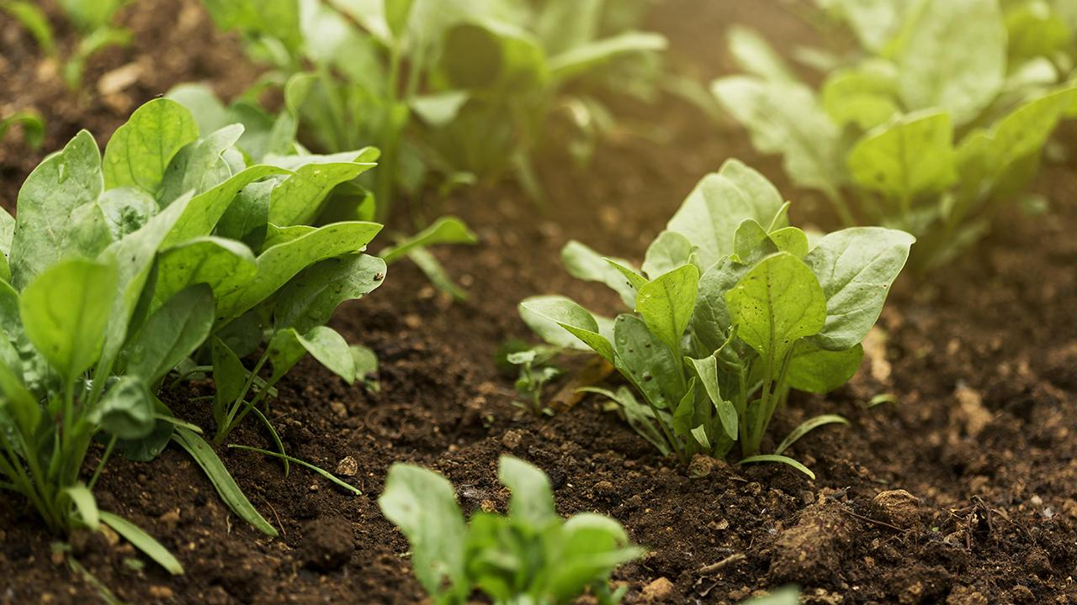

RMCT Research Proposal
MANREEN KAUR A/P JAGJIT SINGH
TP071290
CT098-3-2-RMCT
DR. MURUGANANTHAN VELAYUTHAM
20TH JUNE 2025

Slide 2
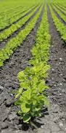
TITLE & ABSTRACT
Title:
Development of an Agri Crop Yield Prediction Model
Abstract:
This research proposes an intelligent crop yield prediction model that uses soil nutrients, environmental conditions, and crop features. The model integrates IoT and Machine Learning to provide precise, real-time yield forecasts, enabling farmers to optimize productivity and support sustainable agriculture through informed decision-making.

Slide 3
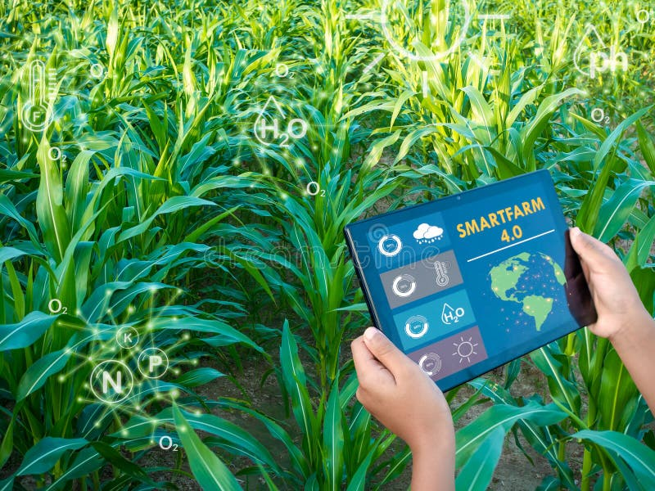
PROBLEM STATEMENT
Key Issue:
Traditional crop yield forecasting methods often
fail to capture the complex interactions among
soil, environment, and crop traits.
Challenges Identified:
Limited integration of multiple data sources (soil NPK, weather, crop types).
Existing models lack adaptability to diverse regions.
Farmers need accurate tools for sustainable and efficient crop management.

Slide 4
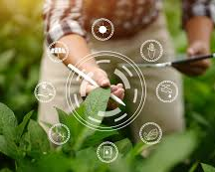
RESEARCH AIM & OBJECTIVES
Aim:
To develop a deep learning and IoT-based crop
yield prediction model using soil, environmental,
and crop data.
Objectives:
Build an ML model using NPK, temperature, humidity, and crop features.
Apply and compare DT, RF, KNN, XGB, and SVM models.
Design a user-friendly desktop GUI using Python (Tkinter).
Evaluate the model's accuracy, precision, and scalability.

Slide 5
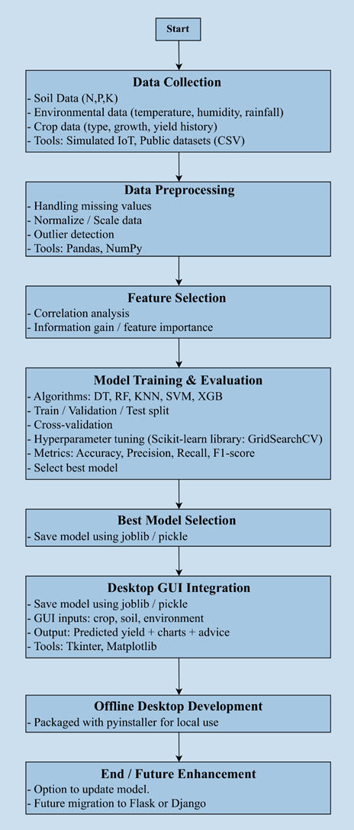
PROPOSED SYSTEM OVERVIEW
System Components:
Data Collection Layer
Gathers soil (NPK), weather, and crop data.
Preprocessing Layer
Cleans, normalizes, and formats the dataset.
Machine Learning Engine
Trains and compares multiple algorithms.
GUI
Desktop app (Tkinter) for input/output visualization.
Deployment
Scalable, offline-friendly desktop system with future web integration potential.

Slide 6
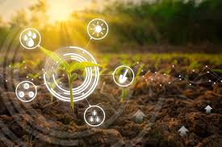
CONTRIBUTION
Purpose & Impact:
Empowering Farmers: Provides data-driven crop management insights.
Food Security: Enhances yield prediction under variable climate conditions.
Sustainability: Reduces overuse of resources like fertilizers and water.
Academic Value: Demonstrates practical ML application in real-world agriculture and offers a foundation for future AI-based agri tools like disease detection and irrigation planning.
Deliverable:
A tangible, easy-to-use desktop software tool integrating smart farming and ML for real-time decision support.

Slide 7
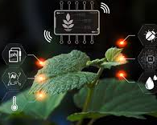
ADDITIONAL INFORMATION
Technologies Used:
Machine Learning: DT, RF, KNN, XGB, SVM
Programming: Python (Pandas, scikit-learn, Tkinter)
Data Sources: IoT sensor data, public agricultural datasets
Deployment: Desktop-based, with scalable architecture
Future Enhancements:
Web-based version using Flask/Django
Integration of satellite or real-time sensor feeds
Expansion to include pest/disease prediction modules

Slide 8
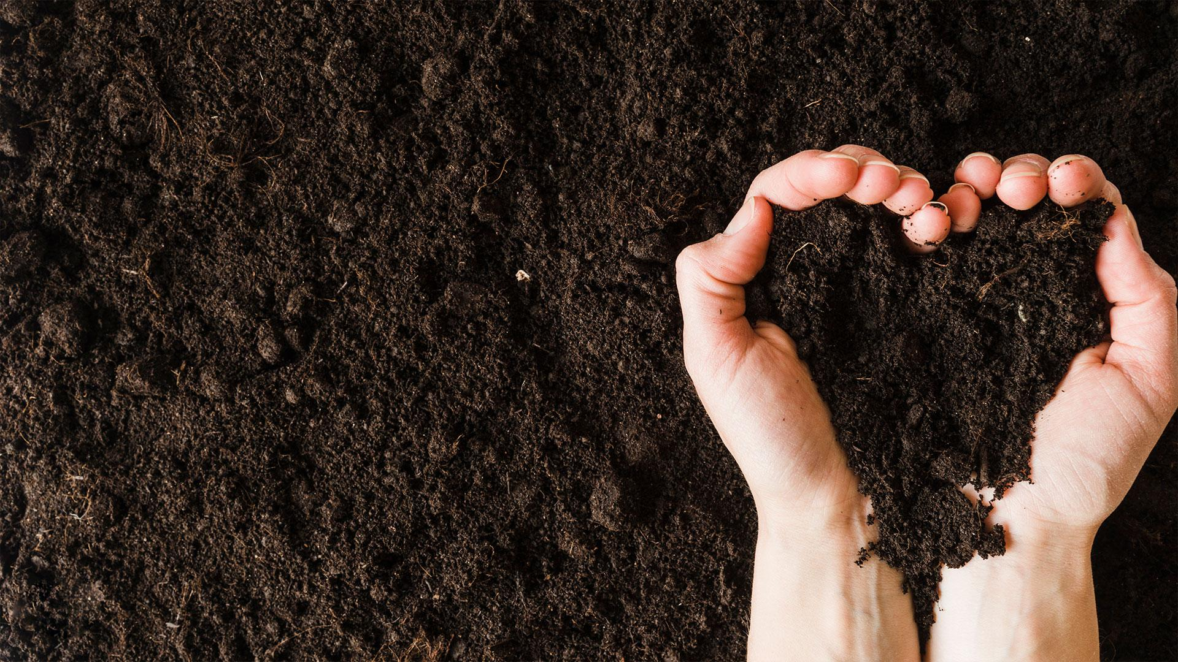
THANK YOU

